Slide 1

Writing your Equine Risks
Arlington/Roe

Slide 2
Welcome to
American Reliable
Introductions

Slide 3
Training Objective
To provide a general understanding of the American Reliable Equine appetite, niches, and endorsements that will help you write business and grow profitably year after year

Slide 4
Agenda
Appetite Review
Farm & Ranch product offering
Equine Liability
Private Horse Owner Liability

Slide 5
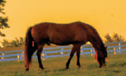
Preferred Classes
  Pleasure
  Boarding
  Breeding
  Training
  Student instruction
  Clinics
  Horse sales/horse shows

Slide 6
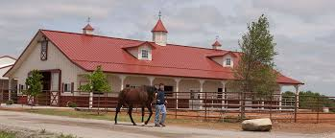
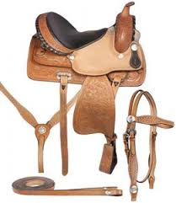
Farm & Ranch - Property
Dwellings
Barns
Stables
Hay
Equipment
Tack

Slide 7
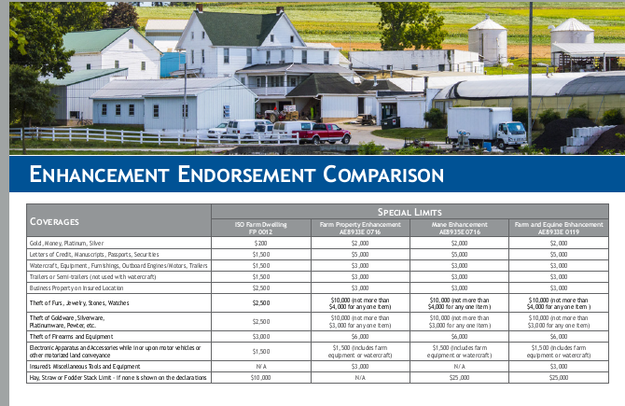
Endorsement Highlights
Farm & Equine Enhancement Endorsement
(Mane Enhancement in IL)

Slide 8
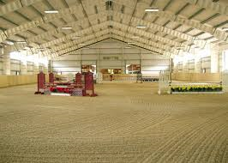
Horse Arena Exposures
Inspections
Replacement Cost Estimators
Permanently installed mirrors can be included in building value

Slide 9
Covering Tack – ARIC Options
  Mane Enhancement/Farm and Equine Enhancement
    $10K coverage for unscheduled tack
    $5K limit for any one item
    $500 deductible applies specifically to this section of endorsement
    $175 charge for endorsement
    Many other highlights to this endorsement which we will review in a bit
  FPP-Scheduled
    ACV coverage
    Option for off premises coverage with no limitation
    Deductible applies (choose deductible on coverage screen)
  Inland Marine
    Replacement cost option
    No off premises limitation
    Deductible applies (choose deductible on coverage screen)

Slide 10
Equine Liability - Highlights
Equestrian operations – stable owners, trainers, instructors, riding clubs, therapeutic riding operations
Limits up to $1M/2M
Private Horse Owner Liability
Care, Custody, Control
CGL classes
Fire legal liability limit - $100K included with optional limits up to $1M
Event policies
Risks with public exposure are required to have Hold Harmless Agreements and signs posted

Slide 11
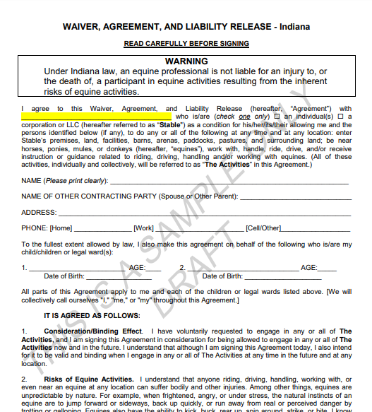
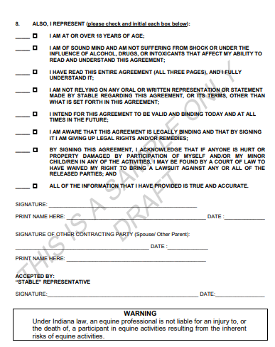
Hold Harmless Agreements

Slide 12
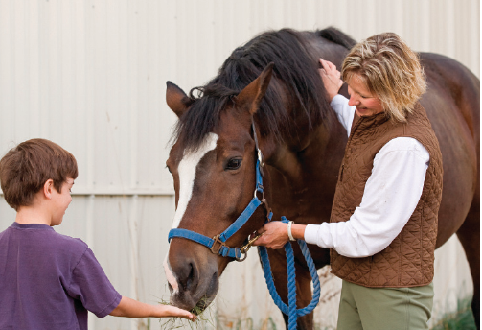
Private Horse Owners Liability –
Off premises boarding
Coverage for BI & property damage caused directly by a horse owned by the insured and scheduled on the policy
Covers horse at a show, parade, event, and where they are boarded
Up to 10 horses
Minimum premium: $275

Slide 13
Horse Exposure – Non-Commercial
Farm Liability:
  (Example - cattle operations, working ranches)
  Ranch Operations: working / cowboy horses working cattle on a ranch
  No Public exposure of riding, training, breeding or selling.
  No charge is made to provide coverage. Equine is included in the definition of “Livestock”
CGL:
Charges will be made for -
  Horses total 4 or more
  Any/all public exposure (EX: 4H, team roping, barrel racing)
  Charge for number of horses under Saddle Animals – Commercial

Slide 14
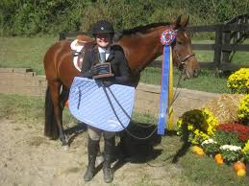
CGL
Horse Shows
Riding Instruction
Riding Clubs
Other CGL class codes

Slide 15
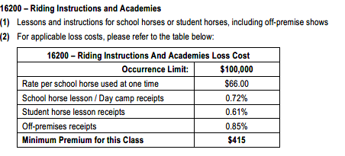
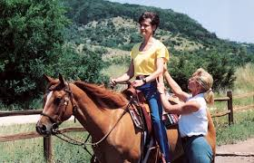
Riding Instructions and Academies - Class Code 16200
Lessons and instructions for school horses or student horses, including off-premise shows
Rate based on receipts

Slide 16
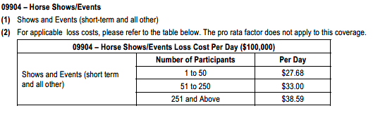
Horse Shows/Events - Class Code 09904
Short term policy for single events or on an annual policy for series of events available
The policy covers the named horse show, its sponsoring organization, individual committee members, judges, officials, course designer and premises owner
We updated the Exclusion Athletic or Sports Participants endorsement with new wording and it is now attaching to all new business automatically. This form will exclude ‘Hunts, Racing, Rodeo-Type Events, Vaulting, Polo and Polo Practices’
Horse Show Application required
Rating based on number of participants and number of days

Slide 17
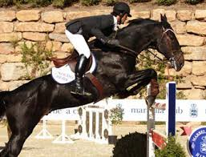
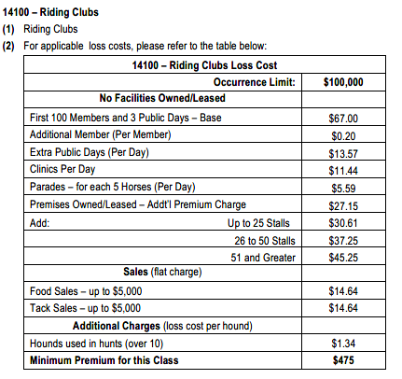
Riding/Clubs - Class Code 14100
Equine related Club Sponsored activities
parades, horse shows, clinics, trail rides
AEP combines coverage for buildings or equipment with the club code if applicable

Slide 18
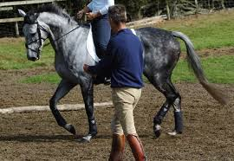
Additional Insured-Independent Instructors/Trainers
Class Code 08201
Expands definition of ‘Who Is an Insured’ to include independent instructors and/or independent trainers while on premises at which insured regularly conducts training or at temporary locations at the direction of the insured.
Example: $500K liability limit = $122 charge

Slide 19
GCL Class Codes
All Rates based on # of horses
Saddle Animals - Commercial - Class code 16401
Stables - Boarding - Class Code 16402
Stables - Training and Boarding - Class Code 16403
Stables - Training - Class Code 16404
Stables - Racing - Class Code 60100
Livestock Sales - Class Code 58500
    Rates based on # days
Clinics - Class Code 16201
Saddle Animals - Activities - Class Code 16300

Slide 20
Care, Custody, Control
Modifies CGL form
Premium based on limit requested and # of horses
Includes coverage for horses in the insured’s care being transported up to 175 miles.
Additional premium charge of $100 can waive the 175 mile radius limitation (check box indicating Transportation Extension)

Slide 21
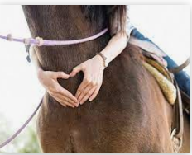
Therapeutic Operations
Appetite
Questionnaire
By referral only
Requires updates on activities every year

Slide 22
Questions?

Slide 23

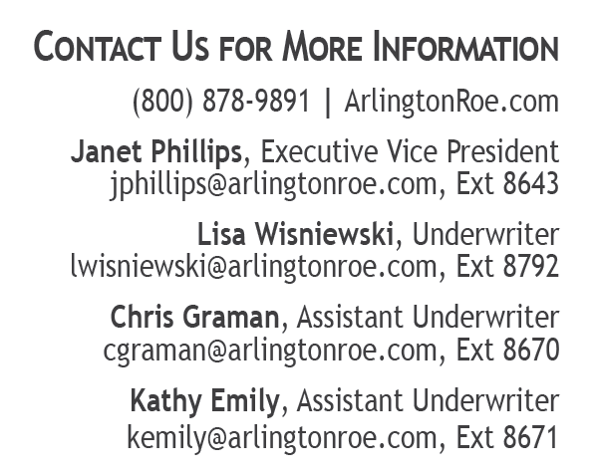
Q&A Session

